Slide 1
TITANIC PROBLEM DATA ANALYSIS
- Dhairya Patel

Slide 2
INDEX
Project Info
Observations
Proof(Dashboards)
Conclusion

Slide 3
PROJECT INFO
Dataset : https://www.kaggle.com/competitions/titanic/data
Tools : Tableau , Excel(For observation using pivot tables)
Objective : To analyze the passenger data and observe under what circumstances the chances of survival is maximum.

Slide 4
NOTE: Only the absolute value of the age in fraction have been taken into consideration for the analysis.
There are more female survivors than male in general.
Among them maximum females are between the age of 10-35 years.
- Females sitting in the passenger class 1 have the maximum chance of survival. (91 of 94 women in class1 survived).
Looking by class, the people in class 1 have the maximum chances of survival.
SibSp and Parch These features have zero correlation for certain values.

Slide 5
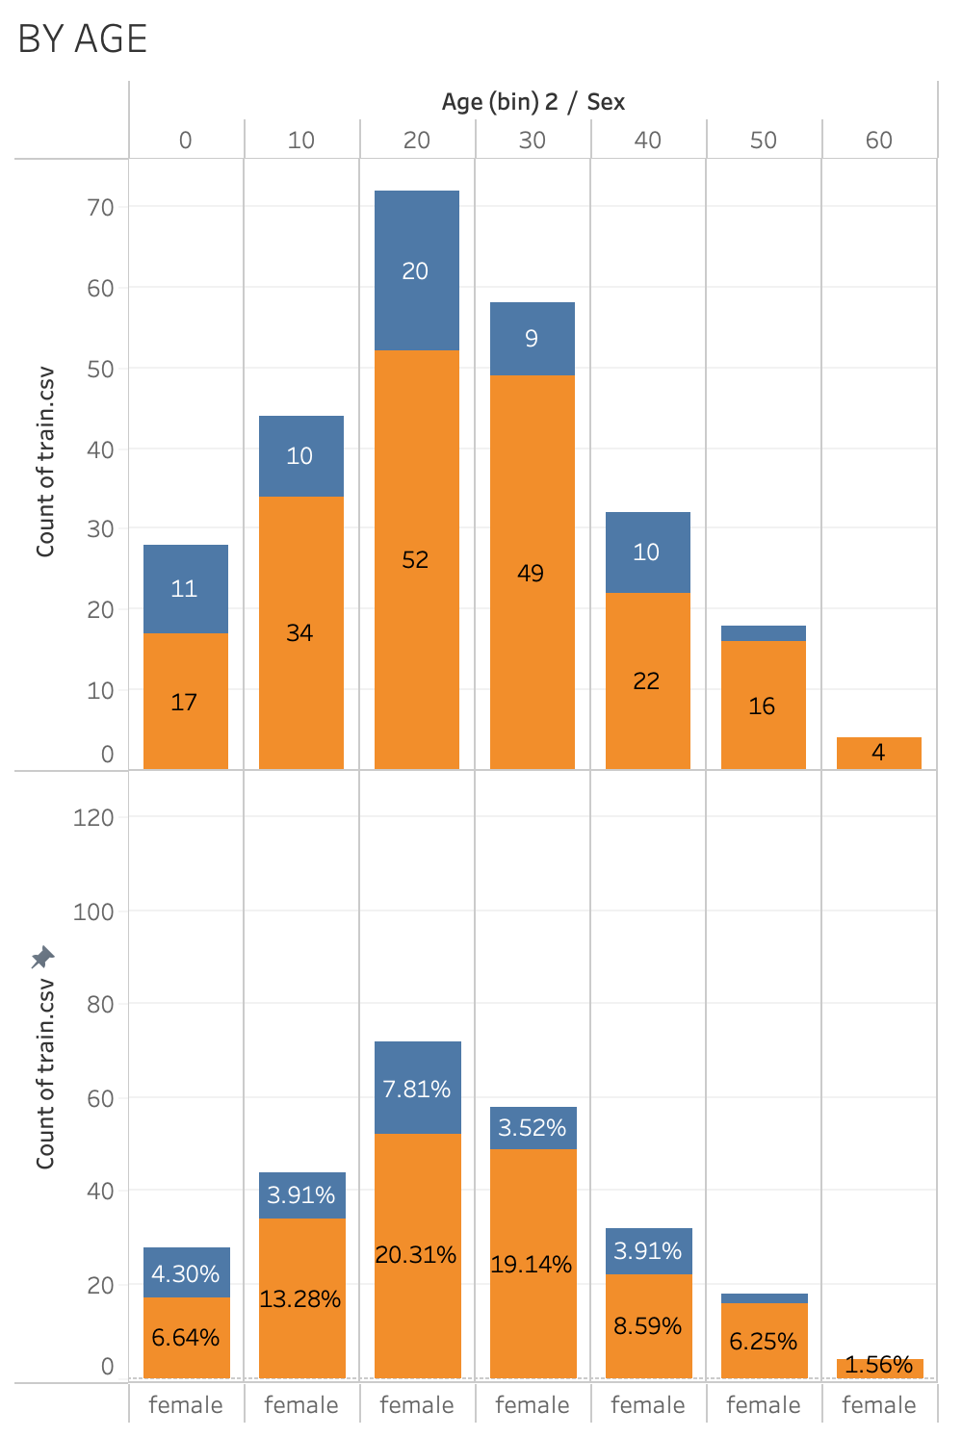
Talking about the general trend, females between the age of 10-30 have better chances of survival. Showing a 77% of survival count on average.
Females in their 20s have the highest chance of survival,being 20.31% of the total female passengers. (Besides proportion of people whose age is unknown)

Slide 6
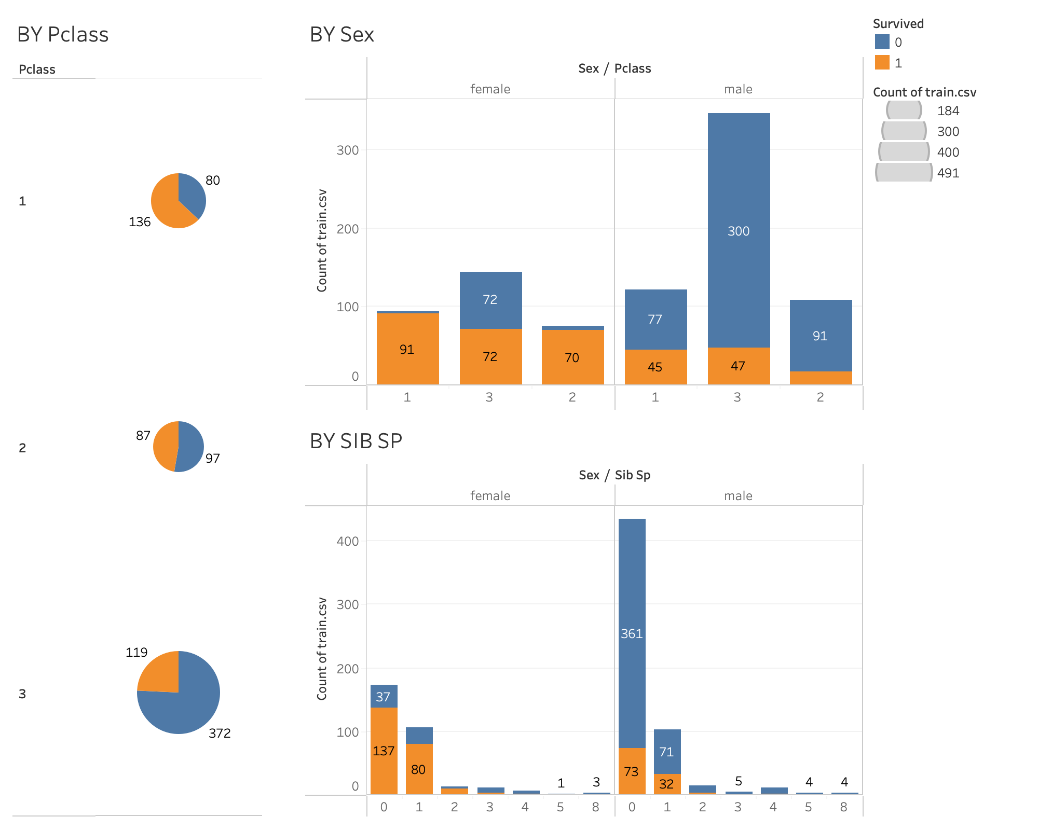
Out of all the classes there are maximum survivors in the class 1.
Classifying by sex among the survivors in different classes, we can observe that from 93 there are 91 female survivors.
(Almost 97% survival rate)
A similar trend of more female survivors
is observed when classification is made on the basis of people with siblings

Slide 7
CONCLUSION
Females between the ages of 10-30 had a better chance of survival compared to other age groups, with an average survival rate of approximately 77%.
-This suggests that factors such as physical resilience or priority in rescue efforts may have contributed to their higher chances of survival.
2.Among the female passengers, those in their 20s had the highest probability of survival, accounting for approximately 20.31% of all female survivors.
-This indicates that young adult females were particularly likely to survive the incident, possibly due to their relative physical fitness and adaptability in critical situations.
3.The first-class passengers had the highest number (136 of 216) of survivors compared to other classes.
-This suggests that individuals in higher socioeconomic classes had better access to life-saving resources, such as lifeboats or priority in evacuation procedures, which increased their chances of survival.

